Slide 1
RED BLACK TREE

Slide 2
Introduction :
MD SIFATULLAH SHEIKH (2022-1-60-029)
URMI KIRTONIA (2022-1-60-184)
NUZATH TABASSUM ARTHI(2022-1-60-185)
AFSARA TASNIM BIVA(2022-1-60-396)

Slide 3
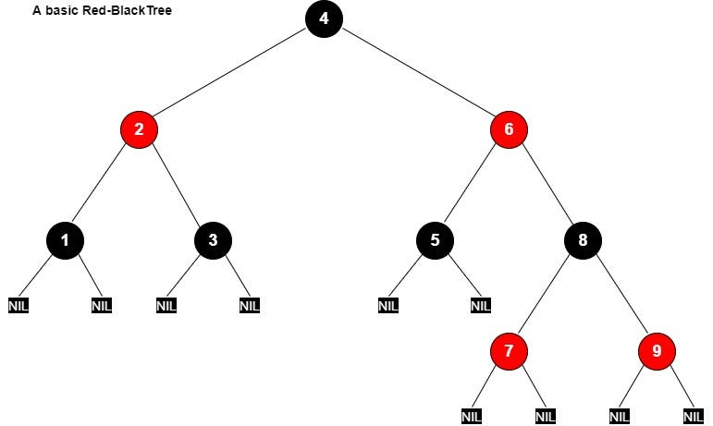
RED BLACK TREE :
Red black tree is a binary search tree in which every node is colored either RED or BLACK.

Slide 4
Why use a red-black tree? A red-black tree is a useful data structure for application development because it offers fast and efficient access to sorted data. It can store any type of data that can be compared, such as numbers, strings, dates, or objects. It can also support dynamic operations, such as adding or removing data, without compromising the performance or the balance of the tree. A red-black tree can also be used to implement other abstract data types, such as sets, maps, or priority queues.

Slide 5
Properties of RED BLACK TREE :
Property 1: Red - Black Tree must be a Binary Search Tree.
Property 2: The ROOT node must be colored BLACK.
Property 3: The children of Red colored node must be colored BLACK. (There should not be two consecutive RED nodes).
Property 4: In all the paths of the tree, there should be same number of BLACK colored nodes.
Property 5: Every new node must be inserted with RED color.
Property 6: Every leaf ( NULL node) must be colored BLACK.

Slide 6
Max Height Red Black Tree
14
12
35
13
21
56
1
43
99
15
25
80
100
70

Slide 7
INSERTION :
The insertion operation in Red Black tree is performed using the following steps.
Step 1 - Check whether tree is Empty.
Step 2 - If tree is Empty then insert the newNode as Root node with color Black and exit from the operation.
Step 3 - If tree is not Empty then insert the newNode as leaf node with color Red.
Step 4 - If the parent of newNode is Black then exit from the operation.
Step 5 - If the parent of newNode is Red then check the color of parent node's sibling of newNode.
Step 6 - If it is colored Black or NULL then make suitable Rotation and Recolor it.
Step 7 - If it is colored Red then perform Recolor. Repeat the same until tree becomes Red Black Tree.

Slide 8
Example of Inserting Sorted Numbers
1 2 3 4 5 6 7 8 9 10
Insert 1. A leaf so
red. Realize it is
root so recolor
to black.
1
1

Slide 9
Insert 2
make 2 red. Parent
is black so done.
1
2

Slide 10
Insert 3
Insert 3. Parent is red. Parent's sibling is black (null) 3 is outside relative to grandparent. Rotate
parent and grandparent
1
2
3
2
1
3

Slide 11
Insert 4
On way down see 2 with 2 red children. Recolor 2 red and children black. Realize 2 is root so color back to black
2
1
3
2
When adding 4 parent is black so done.
1
3
4

Slide 12
Insert 5
5's parent is red. Parent's sibling is black (null). 5 is outside relative to grandparent (3) so rotate parent and grandparent then recolor
2
1
3
4
5

Slide 13
Finish insert of 5
2
1
4
3
5

Slide 14
Insert 6
On way down see 4 with 2 red children. Make 4 red and children black. 4's parent is black so no problem.
2
1
4
3
5

Slide 15
Finishing insert of 6
6's parent is black so done.
2
1
4
3
5
6

Slide 16
Insert 7
7's parent is red. Parent's sibling is black (null). 7 is outside relative to grandparent (5) so rotate parent and grandparent then recolor
2
1
4
3
5
6
7

Slide 17
Finish insert of 7
2
1
4
3
6
5
7

Slide 18
Insert 8
On way down see 6 with 2 red children. Make 6 red and children black. This creates a problem because 6's parent, 4, is also red. Must perform rotation.
2
1
4
3
6
5
7

Slide 19
Still Inserting 8
2
Recolored now need to rotate
1
4
3
6
5
7

Slide 20
Finish inserting 8
4
Recolored now need to rotate
2
6
1
3
5
7
8

Slide 21
Insert 9
4
2
6
1
3
5
7
On way down see 4 has two red children so recolor 4 red and children black. Realize 4 is the root so recolor black
8
9

Slide 22
Finish Inserting 9
4
2
6
1
3
5
8
7
9
After rotations and recoloring

Slide 23
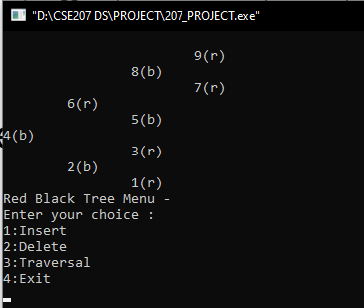
RED BLACK TREE output of the code :

Slide 24
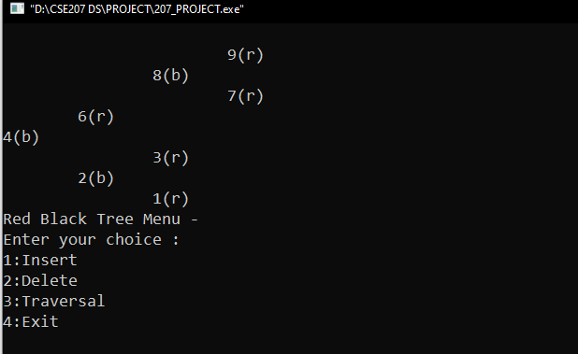
Deletion :
Delete 5 :

Slide 25
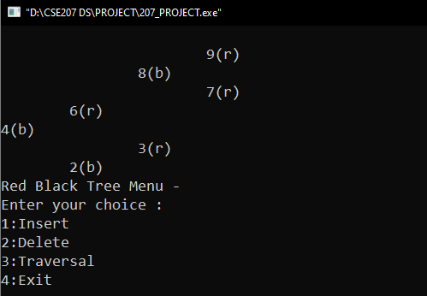
Deletion :
Delete 1 :

Slide 26

Deletion :
Delete 8 :

Slide 27
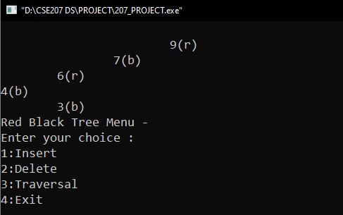
Deletion :
Delete 2 :

Slide 28
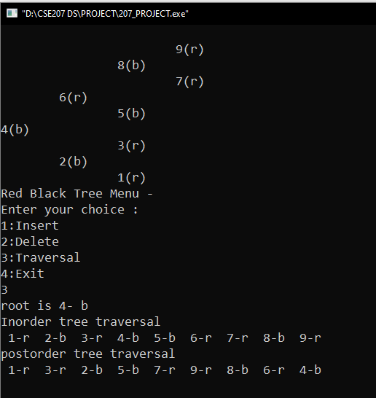
Traversal:
Inorder(root):
Follow step 2 to 4 until root != NULL
Inorder (root -> left)
Write root -> data
Inorder (root -> right)
End loop
Postorder(root):
Follow step 2 to 4 until root != NULL
Postorder (root -> left)
Postorder (root -> right)
Write root -> data
End loop

Slide 29
APPLICATION
RED-BLACK TREE IN APPLICATION DEVELOPMENT
A red-black tree can be employed in a variety of scenarios where sorted data needs to be stored and manipulated efficiently.
For instance, it can be used to implement a database index that facilitates fast queries and updates on a large amount of data, or as a scheduler for prioritizing tasks based on their deadlines or importance.
Additionally, a red-black tree can be utilized to build a spell checker for searching words in a dictionary, as well as a game engine that utilizes a scene graph for organizing and rendering objects in a 3D space.
Real-world uses of red-black trees include TreeSet, TreeMap, and Hashmap in the Java Collections Library.

Slide 30
Conclusion :
Red-black trees are especially useful if we require good average cost for insertion and search, as well as guaranteed logarithmic worst-case costs for these two operations.
Furthermore, red-black trees are a good choice if we have frequent updates to our tree, as the rebalancing costs are lower than for other balanced trees like AVL or B-trees

Slide 31

Thank you for your time.

